Slide 1
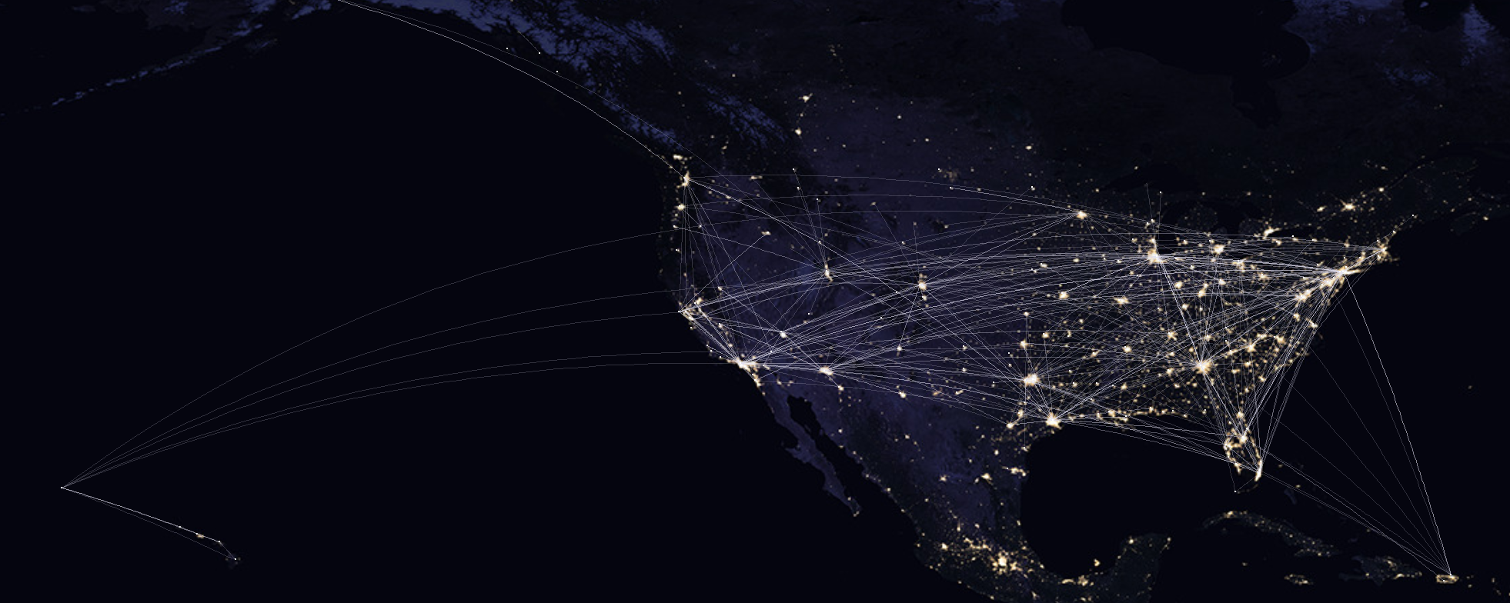
Airline Satisfaction Survey
IST 687-Project By :
Madhu Chheda | Madhavi Kadam | Ruifeng Chen | Shuming Song | Yash Kapadia

Slide 2

Overview of our Approach
Initial data: 129889 observations based on 28 variables
Our focus is on customers who successfully took the flight
Cleaned the Data set & replace NA values by the mean value
Understood the attribute affinity using Correlation matrix
Modelling Techniques: Linear Modelling, Association Rule Mining
Modelling Techniques for Validation: Support Vector Machine, Random Forest

Slide 3



Business Questions
Defining Aspect:
-Characteristics of customers with low satisfaction & high satisfaction
-Attributes influencing the likelihood of customers highly grading the airline services
Analysis Aspect:
-Possible attributes which affect the customer’s satisfaction individually
-Negatively or Positively
-Converting detractors into promoters
Recommendation Aspect:
-Services which needed to be focused on increasing overall satisfaction
-Ways of predicting satisfaction
-Corrective actions

Slide 4
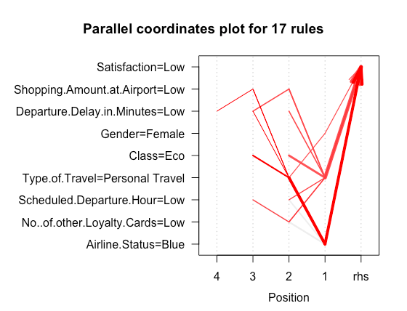

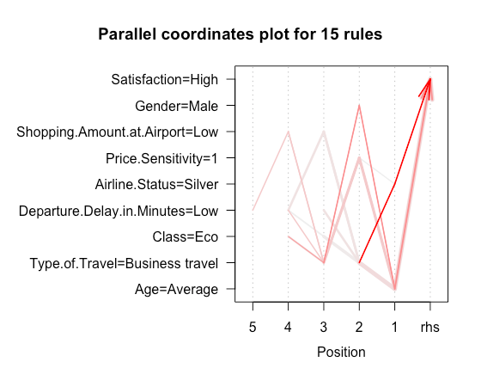

i.Characteristics of customers
Customers in low Satisfaction:
Female
Personal travellers
Blue status customers
Not experienced with flights
Customers in high Satisfaction:
Male
In middle Age
Silver membership of airline
Usually have business travels
Don’t worry about price very much

Slide 5
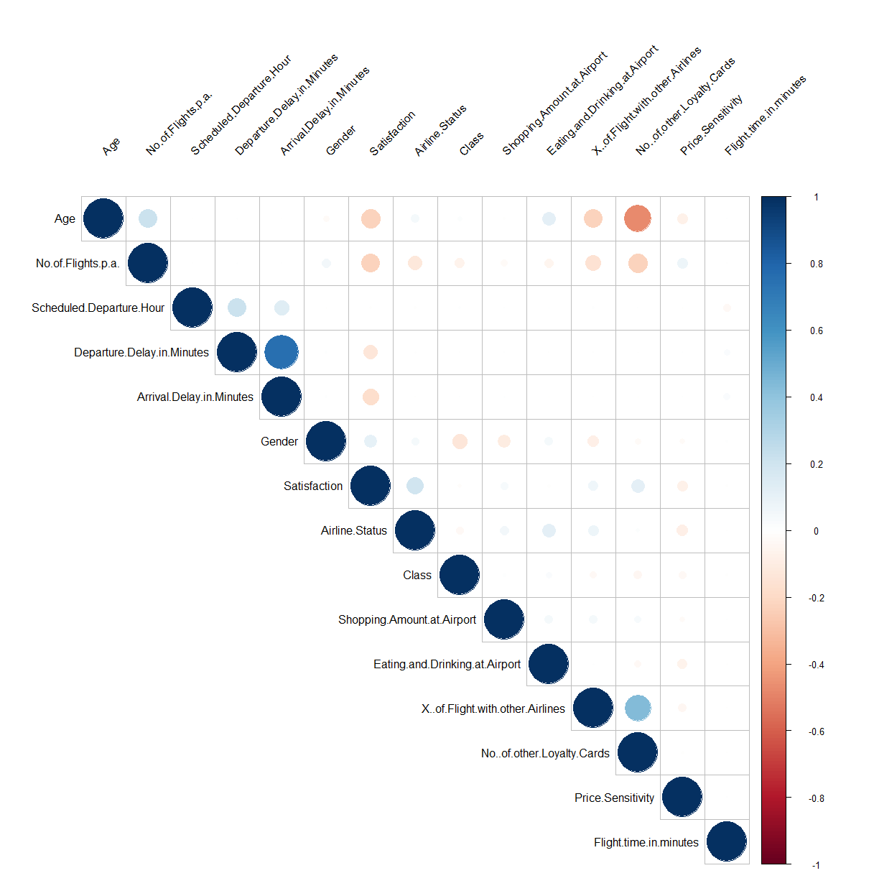
ii.Attributes affecting the Satisfaction
Correlation Matrix: Understanding the Affinity of the attributes
Factors affecting Customer Satisfaction:
Airline Status
Gender
Number of Loyalty Cards
% of Flight with Other Airlines
Shopping Amount at Airport
Arrival Delay in Minutes
Departure Delay in Minutes
Number of flights per annum
Age

Slide 6
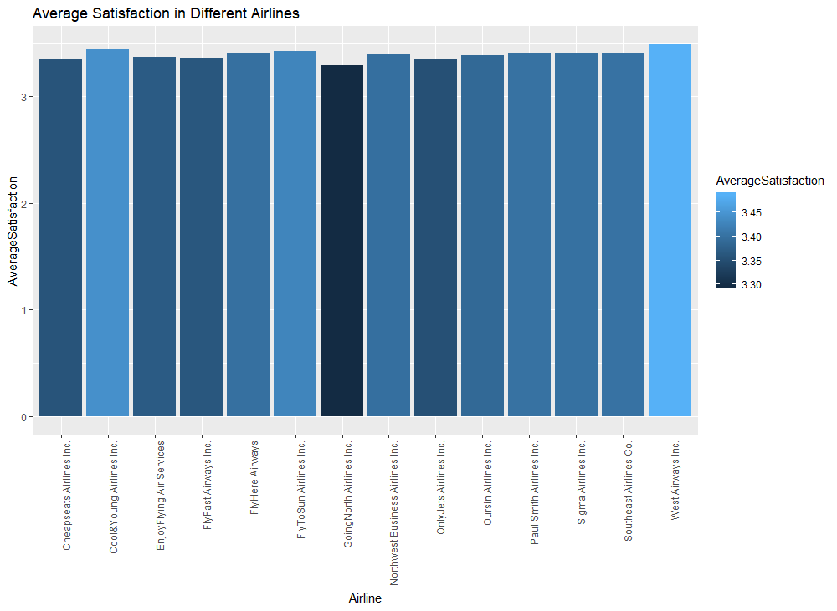
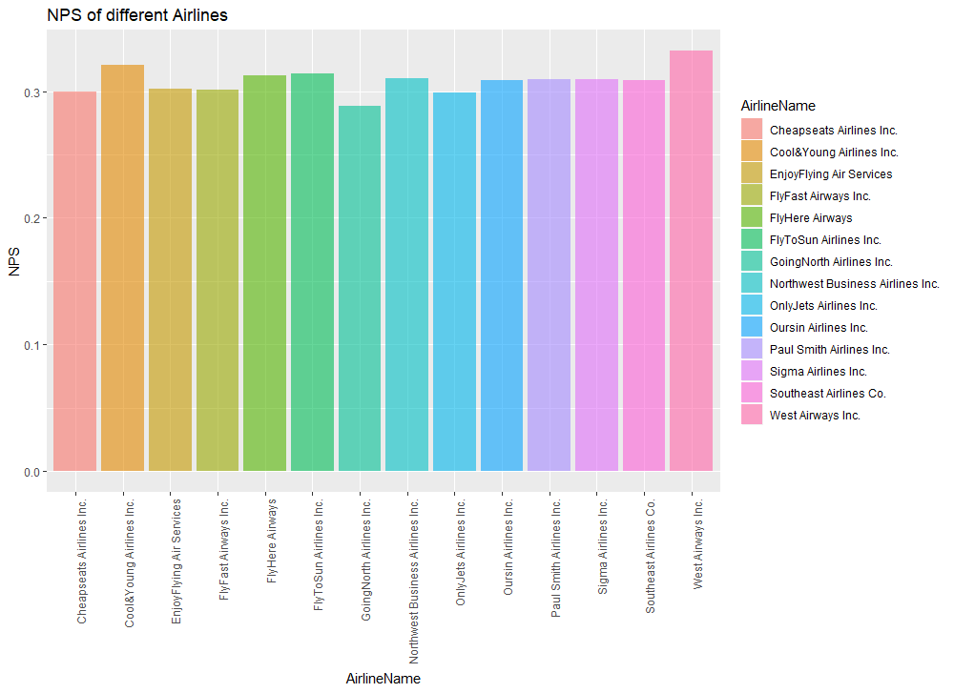
iii. Negatively or Positively - Prepare
Preparation: NPS
Both the average satisfaction and the NPS score of different airline companies are very similar to each others.
Will all the attributes perform similarly on different airline companies? Following analysis are required.

Slide 7
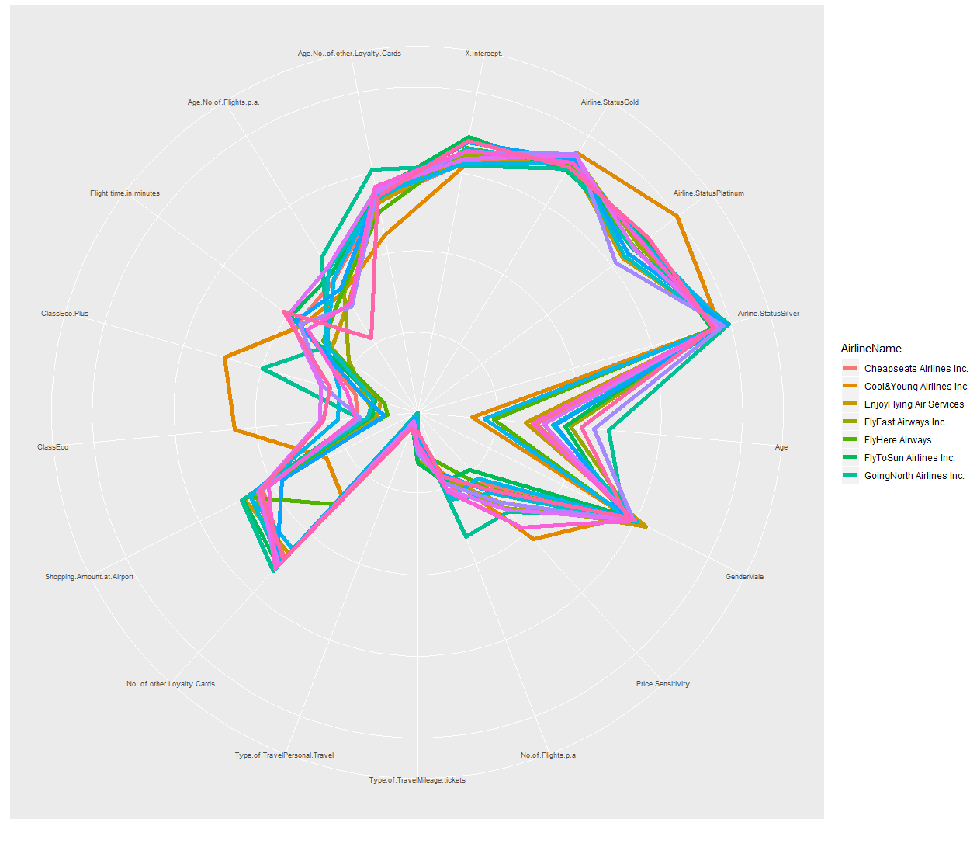
iii. Negatively or Positively
Modeling: Linear Modeling
Significant Attributes vs Different Airlines
Middle Point: Negative
Outside Point: Positive

Slide 8
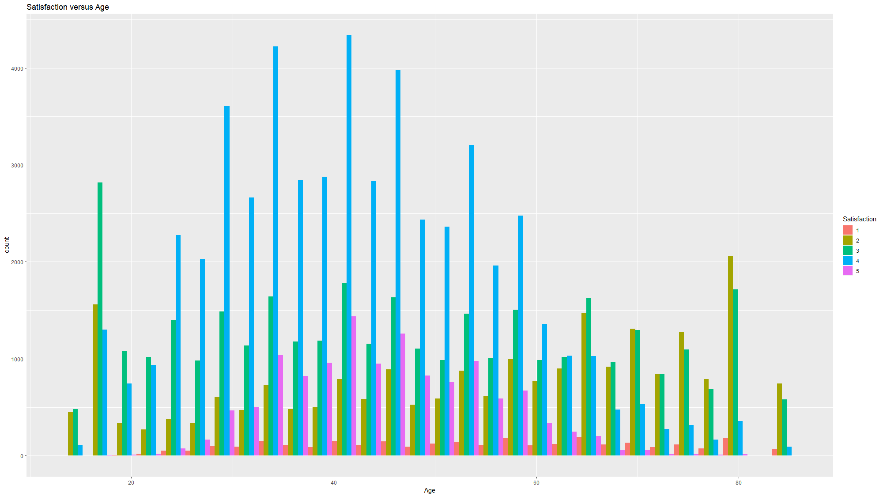
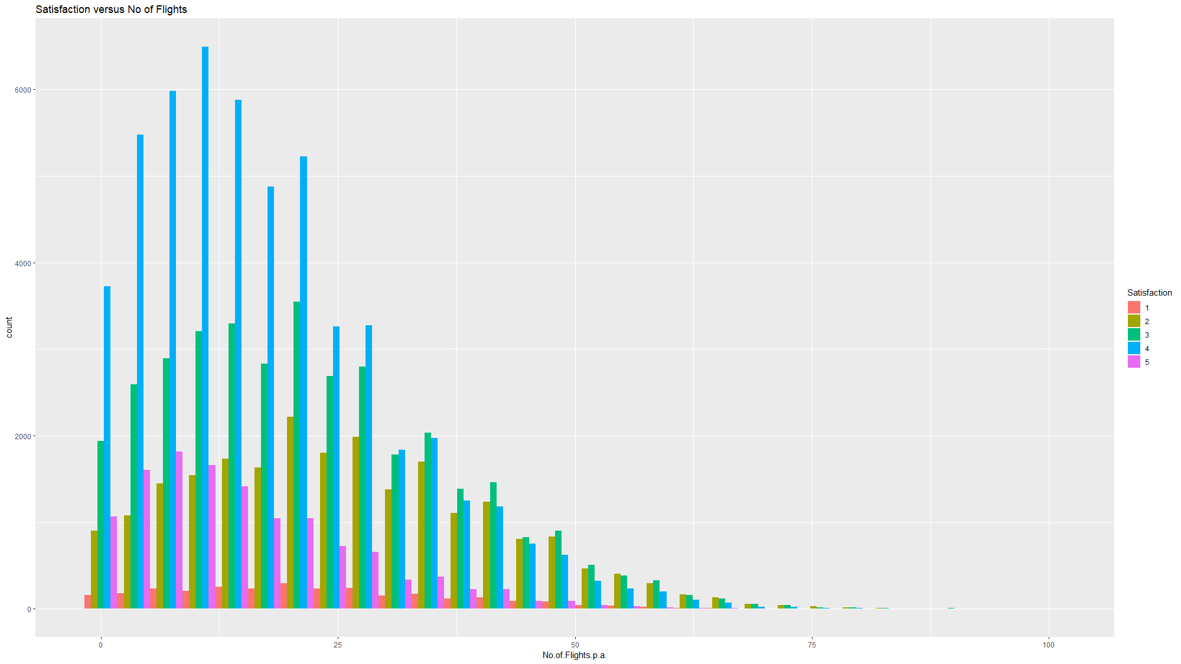
iii. Negatively or Positively - Check
Method: GGPLOT2
The plots for one -to -one relationships are applied for convalidating the result got from the linear modeling.

Slide 9
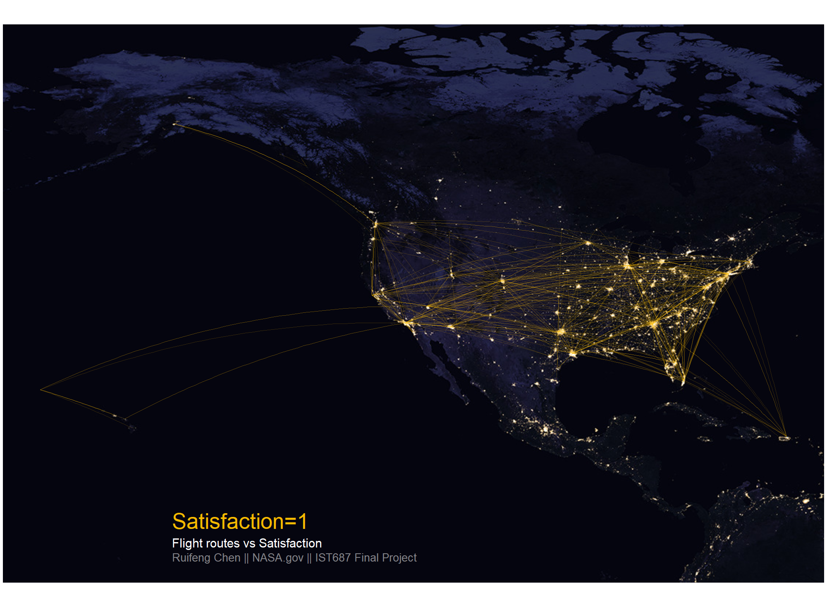
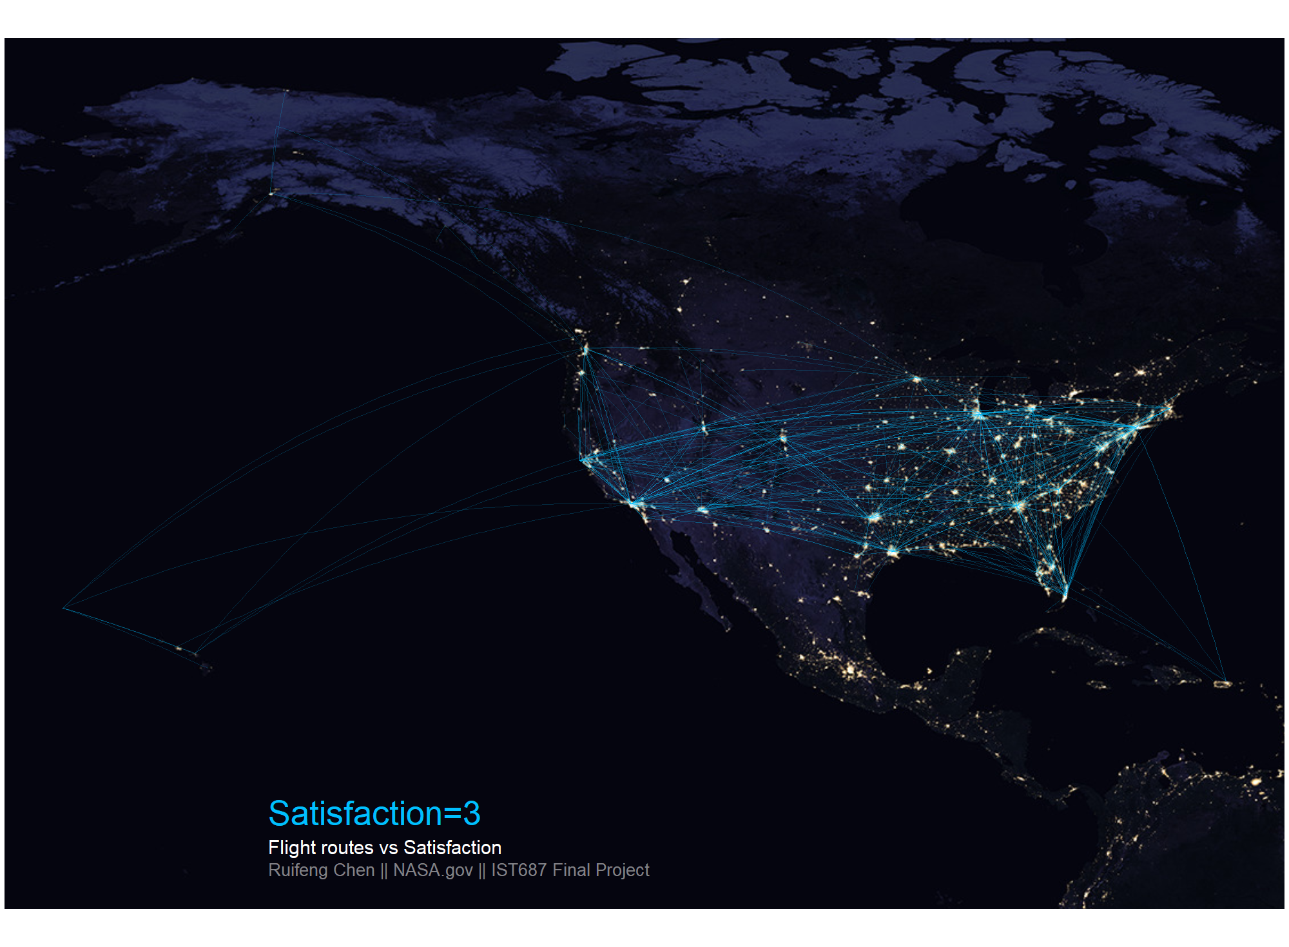
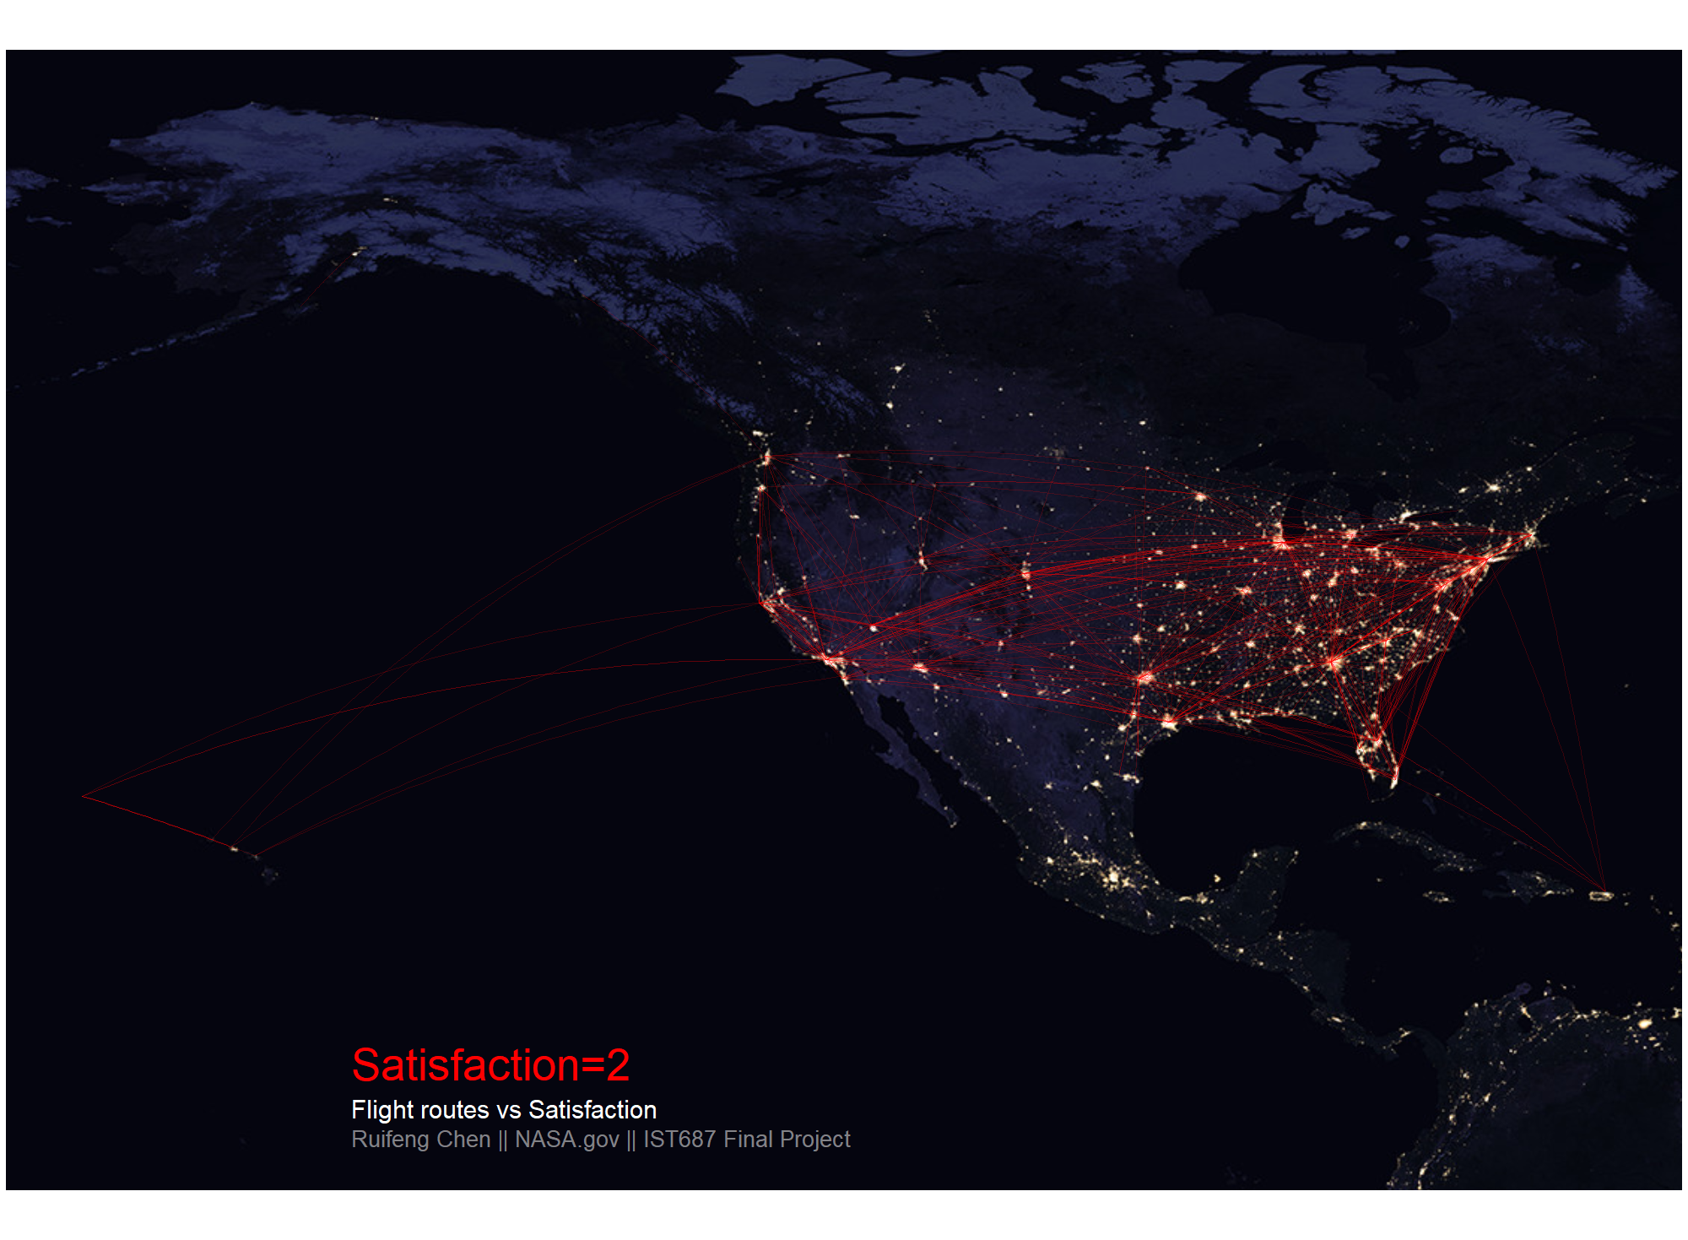
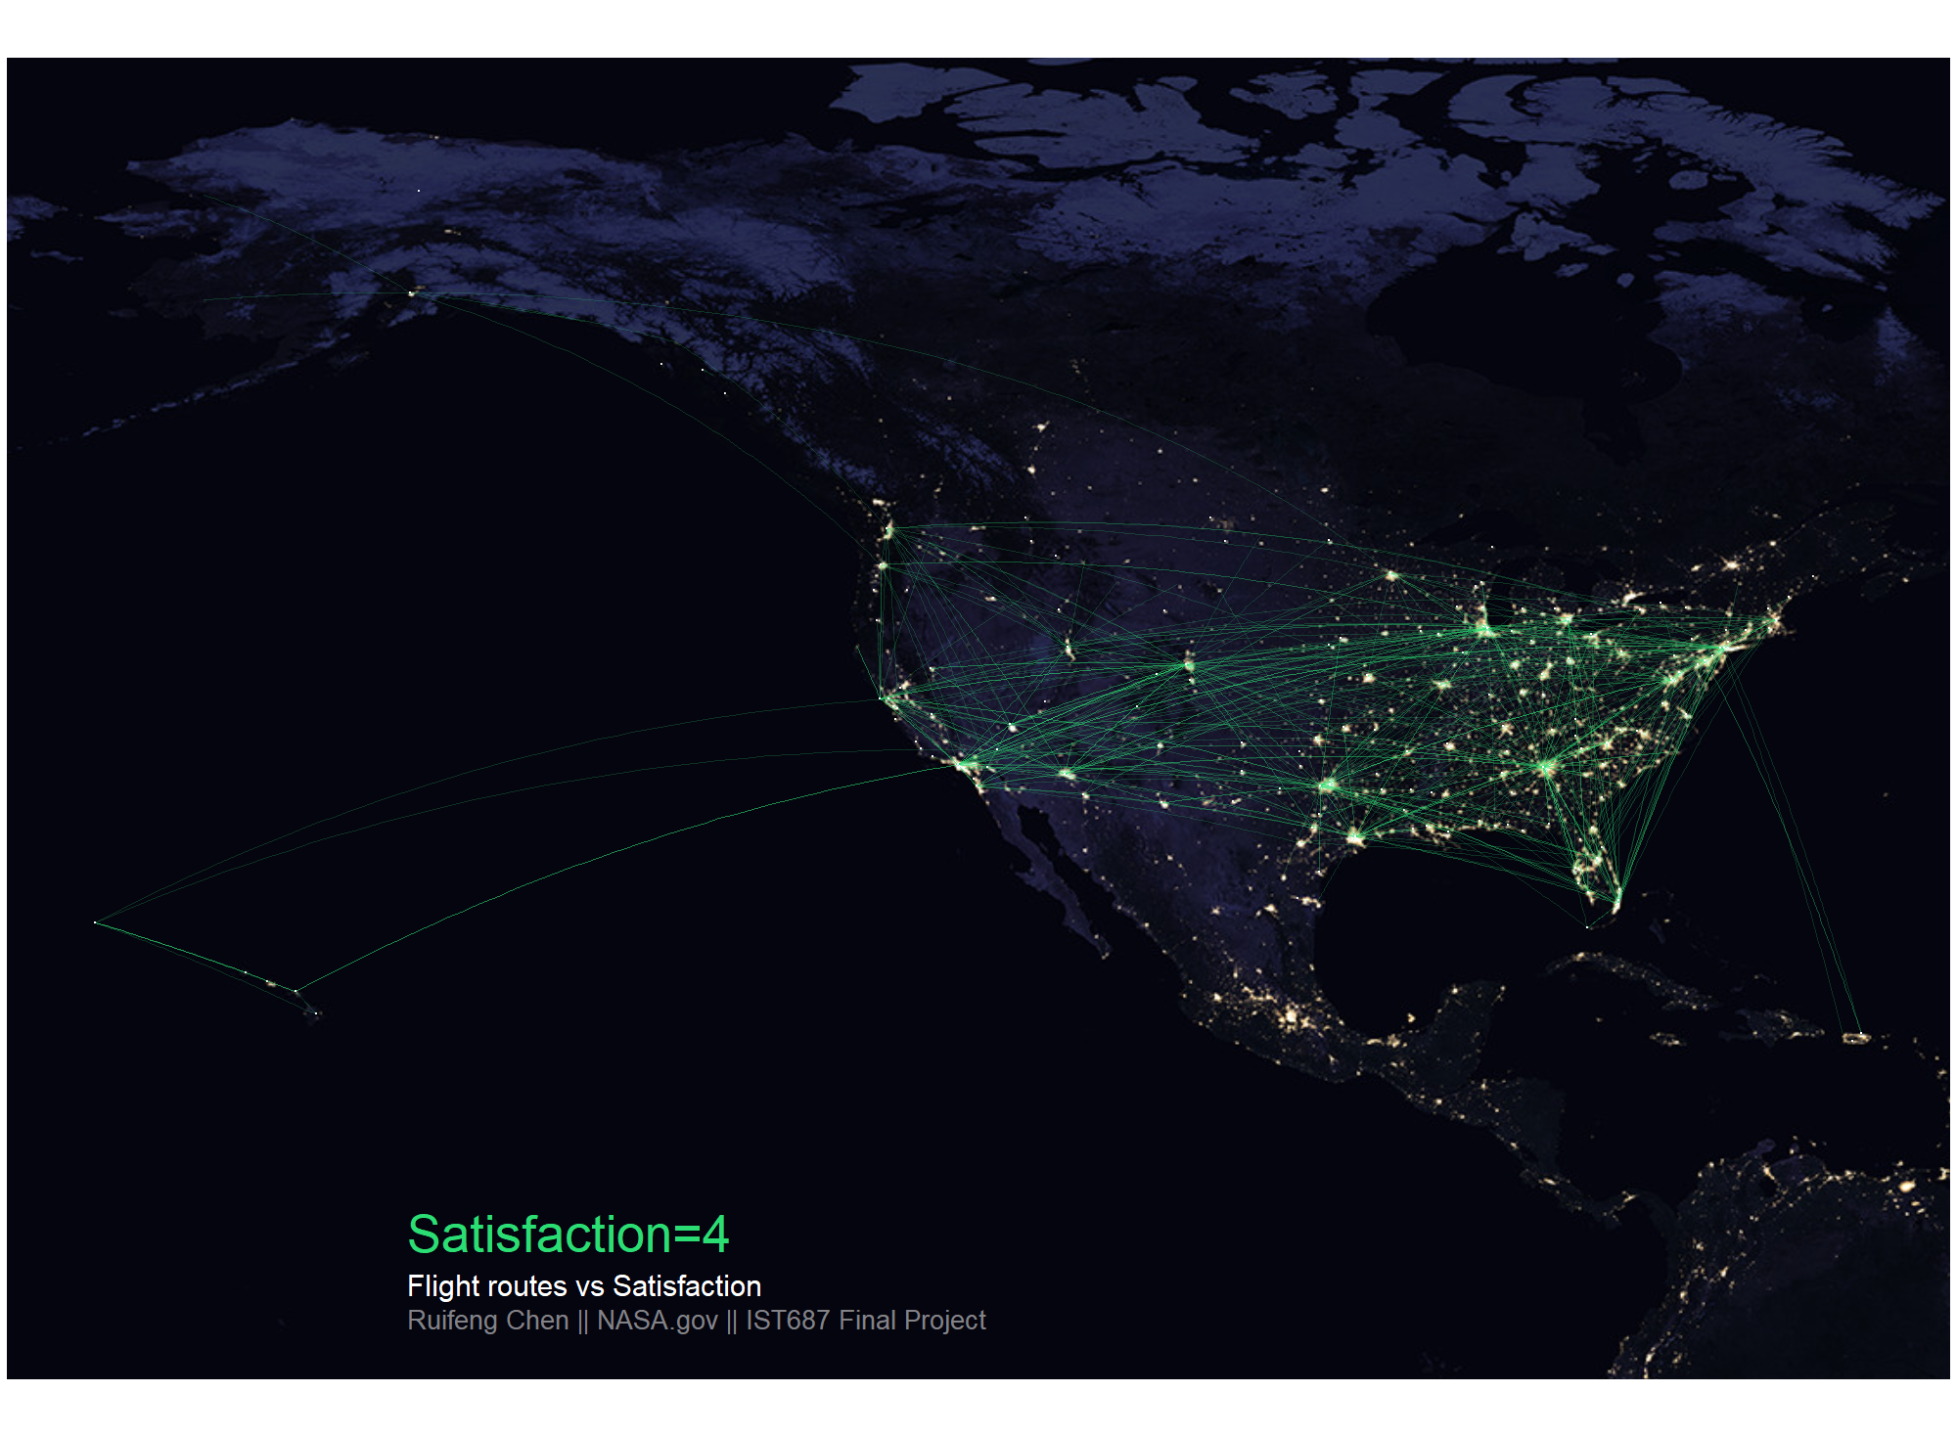
iv. Check Other Attributes
Method: GGPLOT2,GGMAP
The map tell the geographical information , and when combined with the satisfaction it will tell their relationships.
The quality of different flight routines doesn’t play a significant role in the satisfaction

Slide 10
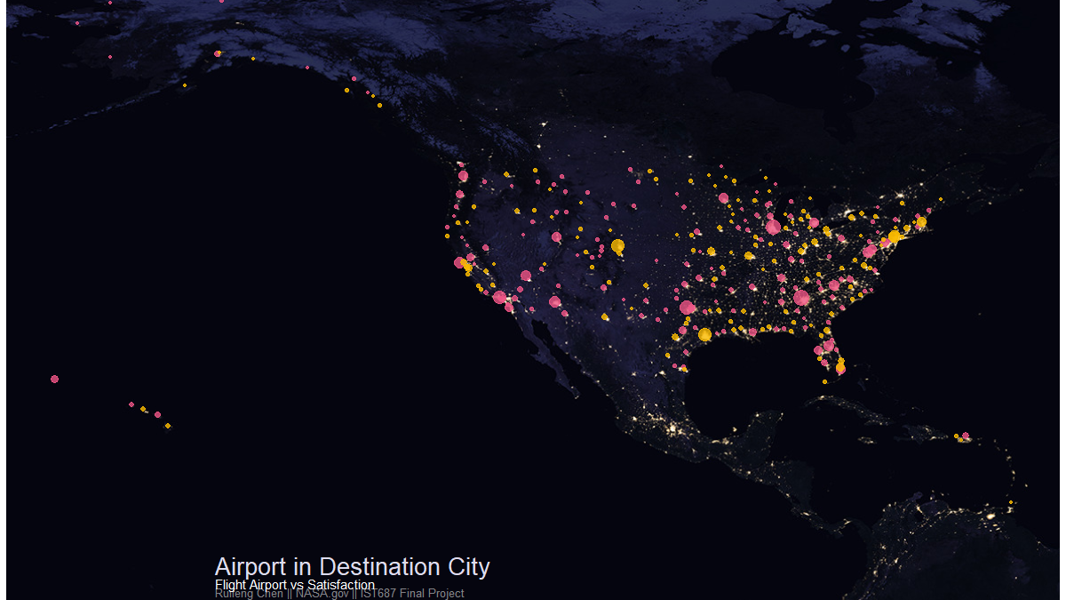
iv. Check Other Attributes
Method: GGPLOT2,GGMAP
The map tell the geographical information , and when combined with the satisfaction it will tell their relationships.
For popular airports, they concentrate more on serving the customer who leaves from the airport than those who arrives at the airport. While some unpopular airport do the opposite

Slide 11
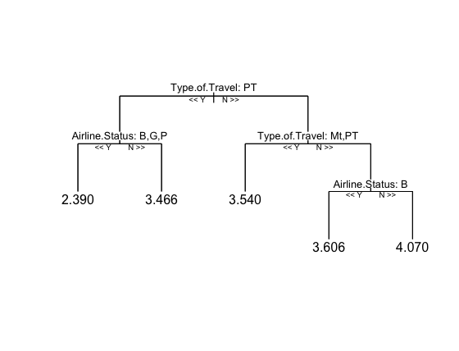
v. Predicting the Satisfaction
Random Forest Model
Support Vector Machine
69%
Accuracy within a range of 1.5
(Prediction from test data)

Slide 12

Actionable Insights
-Solution of low Satisfaction
Airline Status: Increase the quality of service for Blue Airline Status. Give perks for Silver and Gold status so that Blue status customers can go ahead for that.
Class of Travel: The quality of services for the economy travelers should be improved to increase the satisfaction rate. Also they should be given chance to upgrade to a higher class.
Type of Travel: Bridge the gap between services provided to personal passengers and others. Give complimentary services to personal travellers and small souvenirs or gifts to kids as a token of memory. If flight is delayed provide snacks to keep them calm.
Gender: Female customers may include women who are pregnant or have a baby/children. So airline company should provide more service for their convenience to get higher satisfaction.

Slide 13

Actionable Insights
-More Suggestions
To avoid the boring emotion, airplane company may consider more ideas to attract customers’ interest, such as change the introduction video or the movies on the airplane often.
Improve the user’s experience during the long-time travel will solve the low satisfaction of longer flight time in minutes.
Some better healthcare services and adding facilities that could help aged people to travel easily from one place to another will help in increasing the satisfaction. Also, more wheelchairs can be made available and a personnel to help with luggage can bring relief to senior citizens. In case of flight delay, they can be provided with help for booking the next available flight
Price sensitivity is the other point of low satisfaction, we believe small discounts or bonus on ticket could be a good trick to get their better feedback.

Slide 14

THANK YOU!

